Slide 1
Christian Valley Park, Community Services District
Water Treatment Plant Access Easement
Survey Conducted on December 30th, 2025

Slide 2
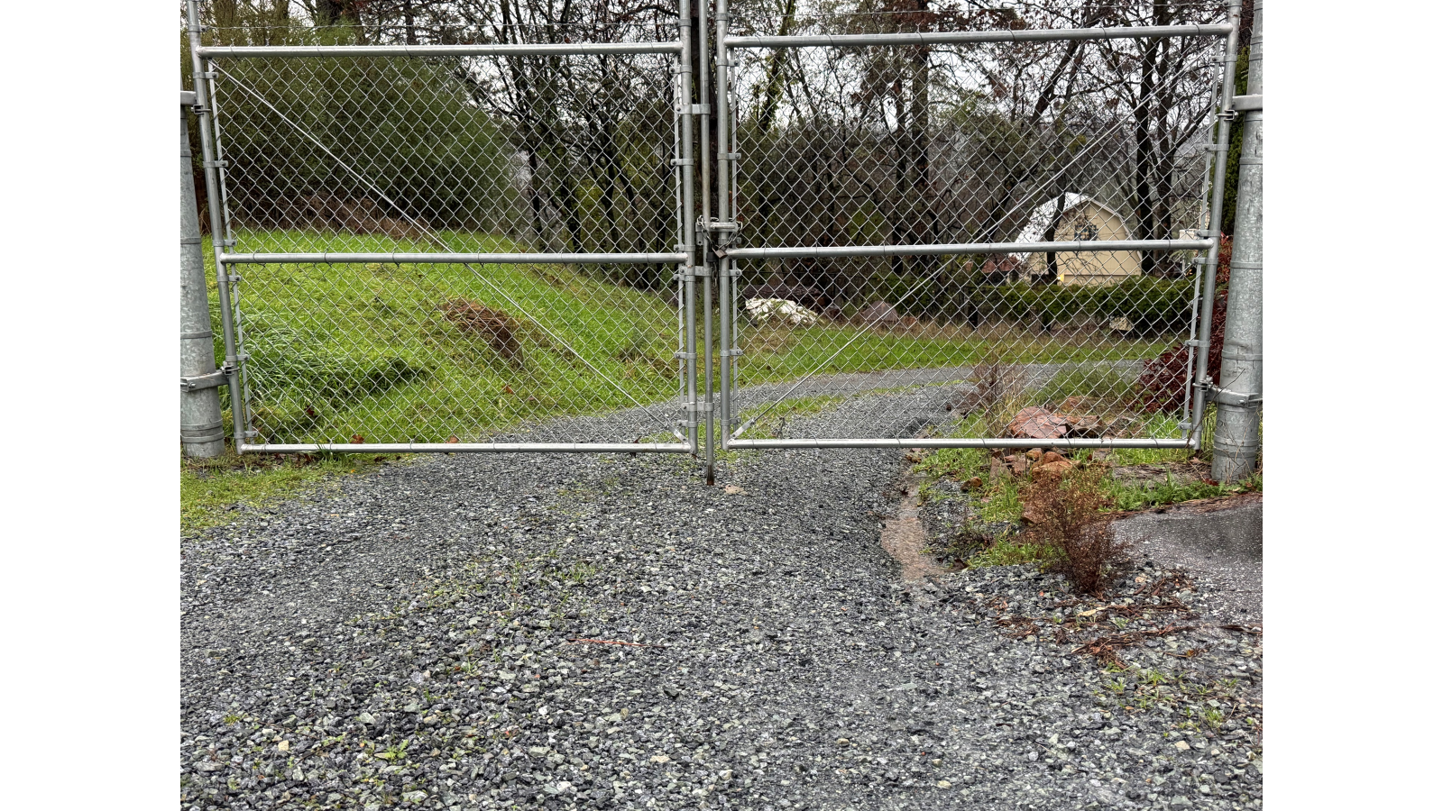
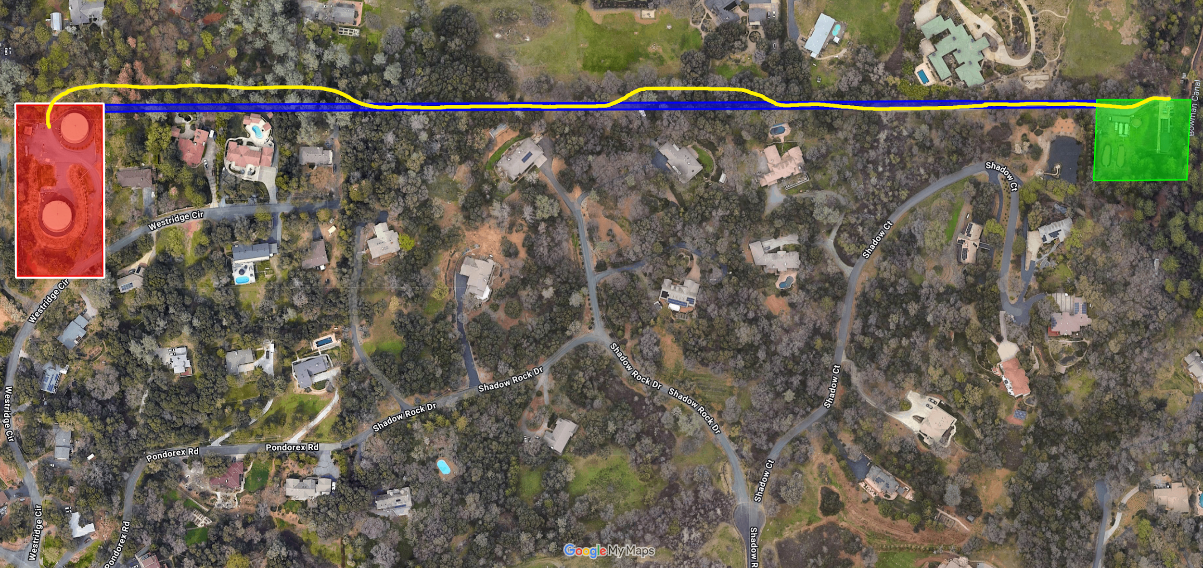
Easement vs Current Usage

Slide 3
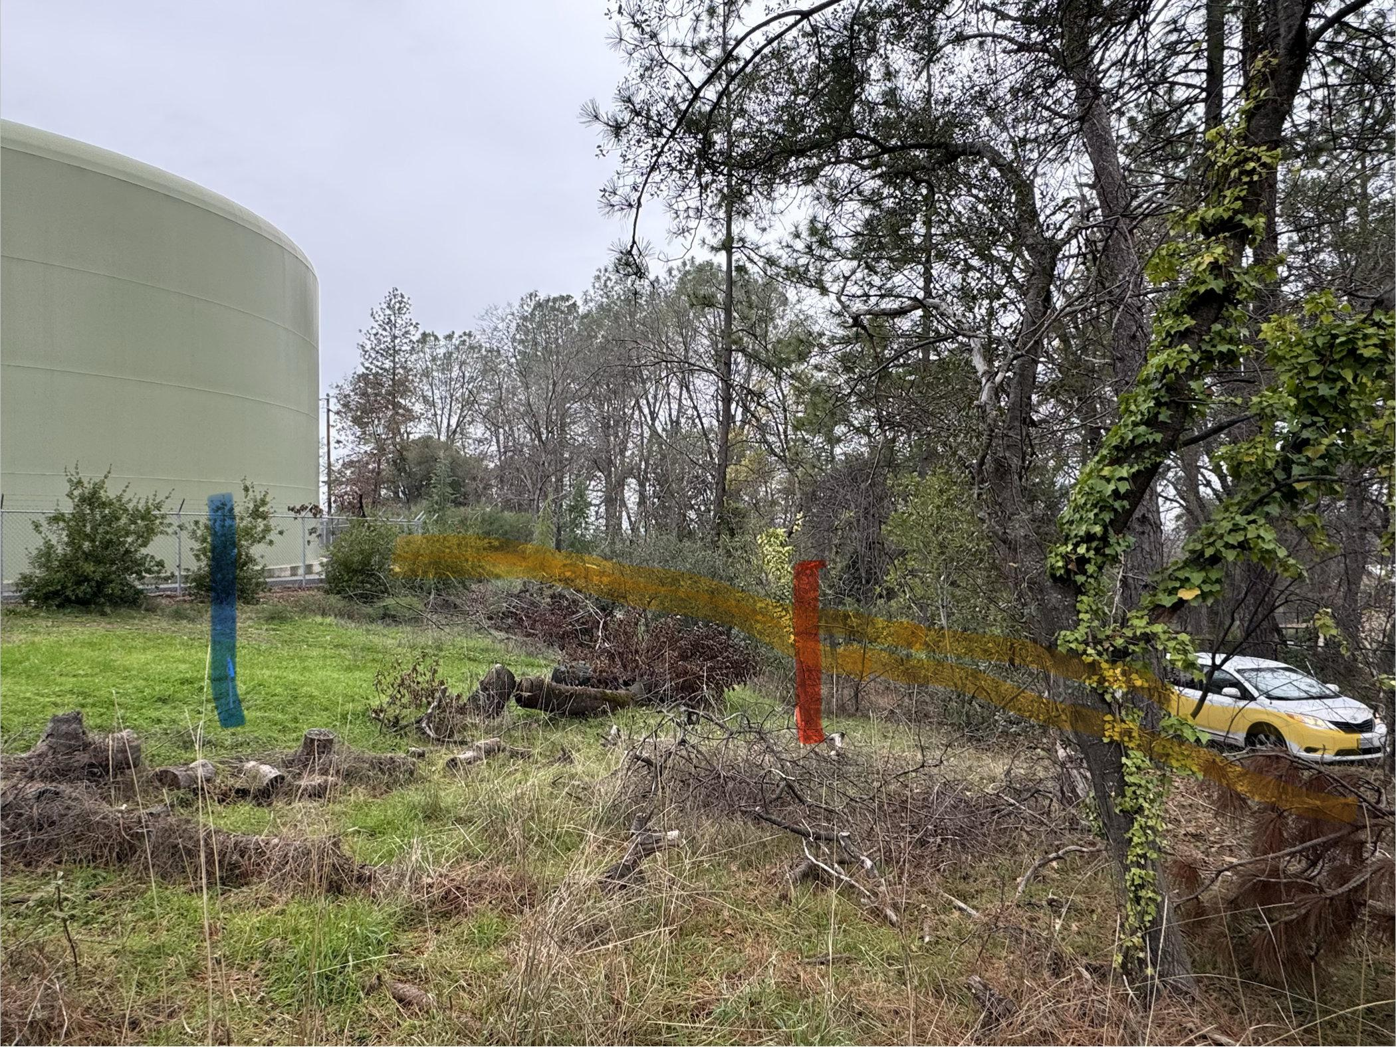
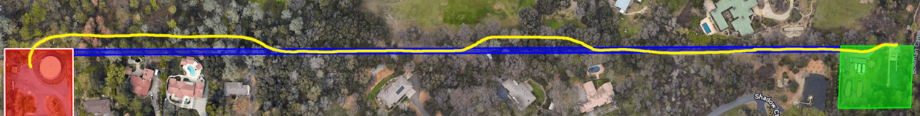

Slide 4
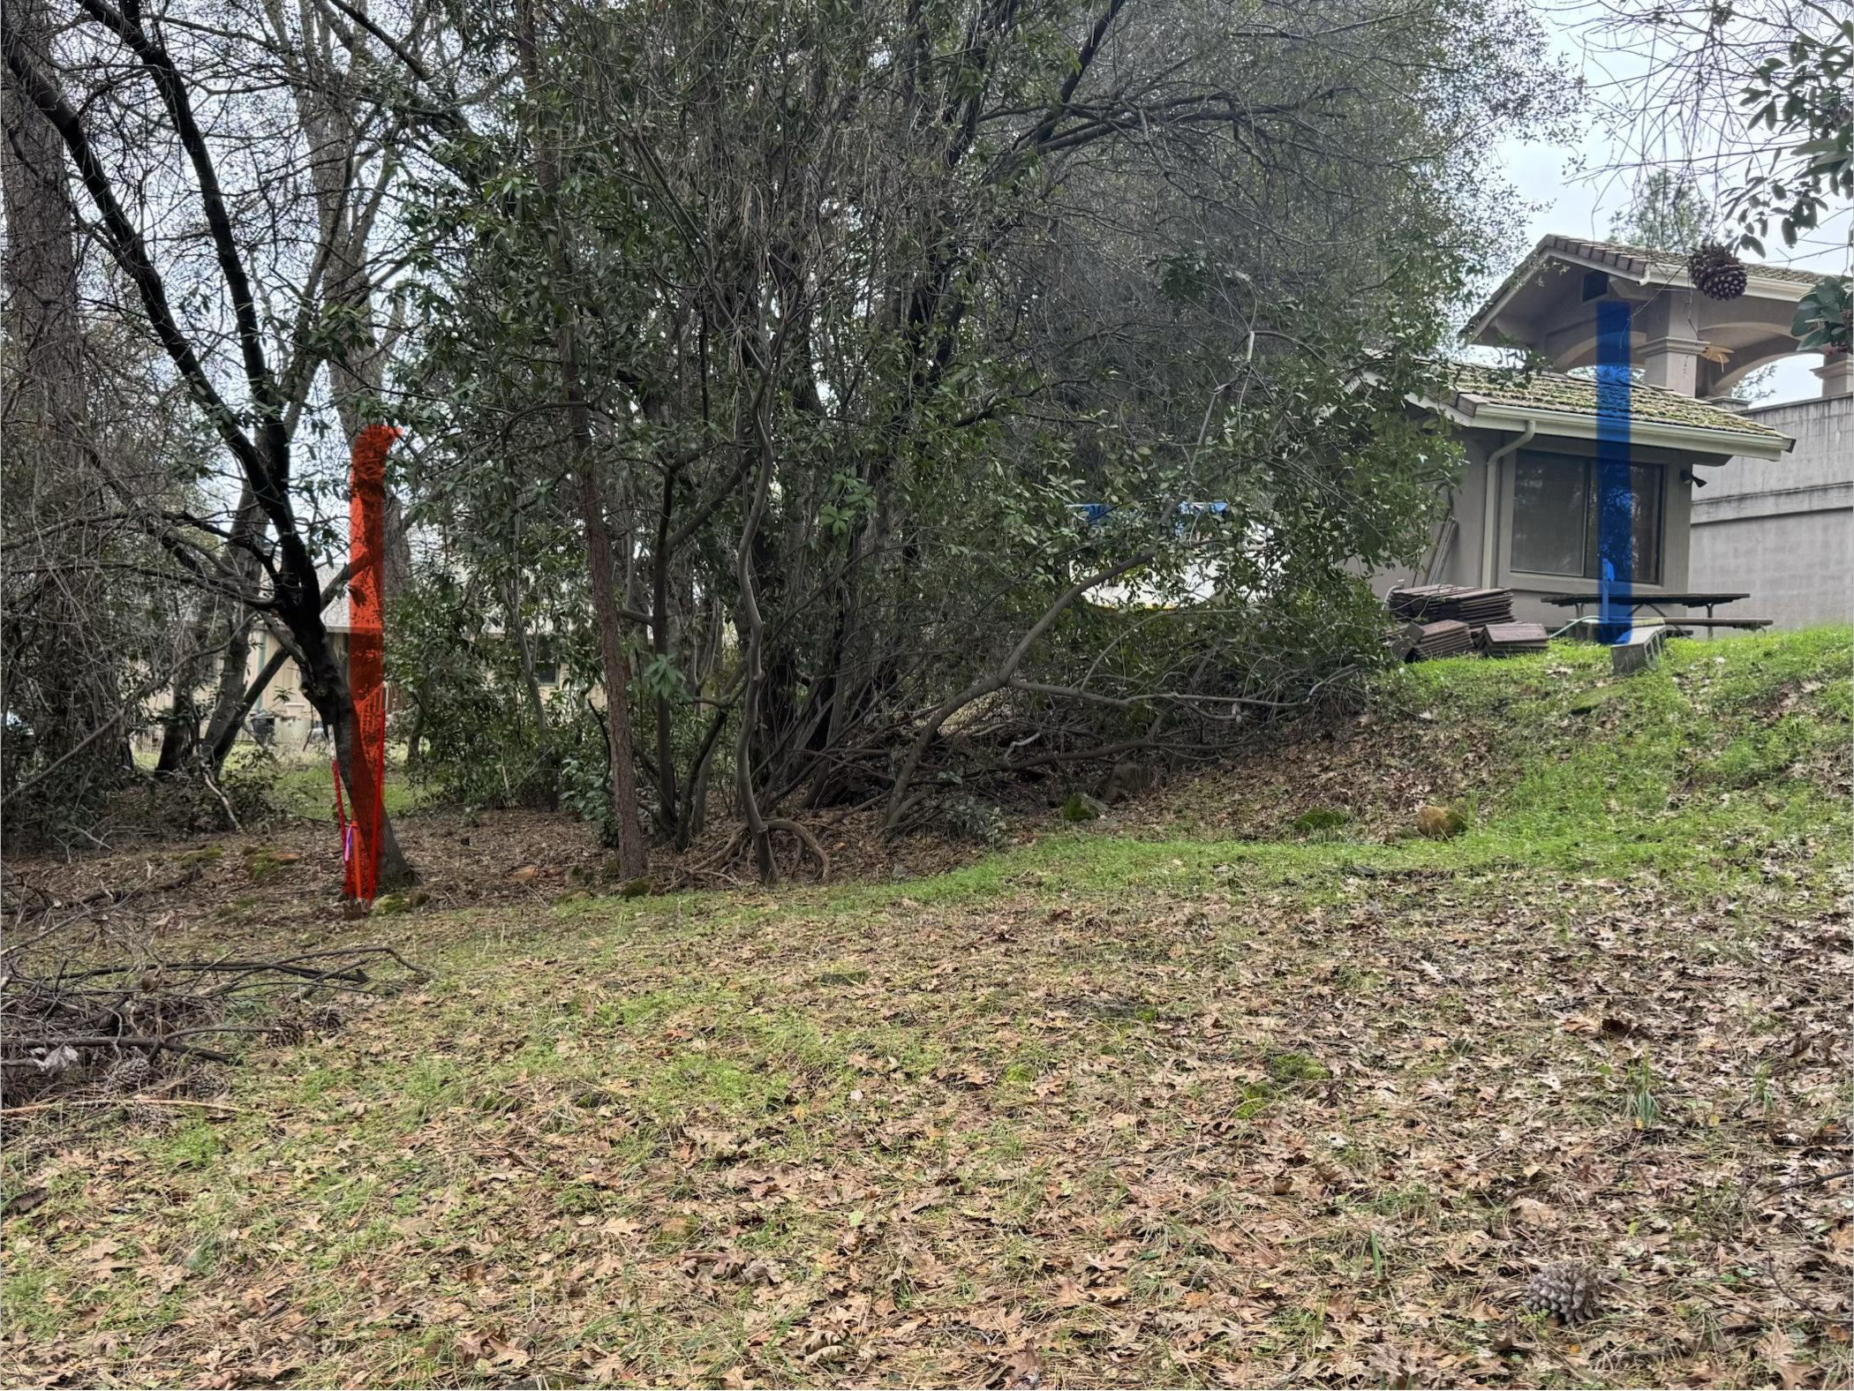

Slide 5
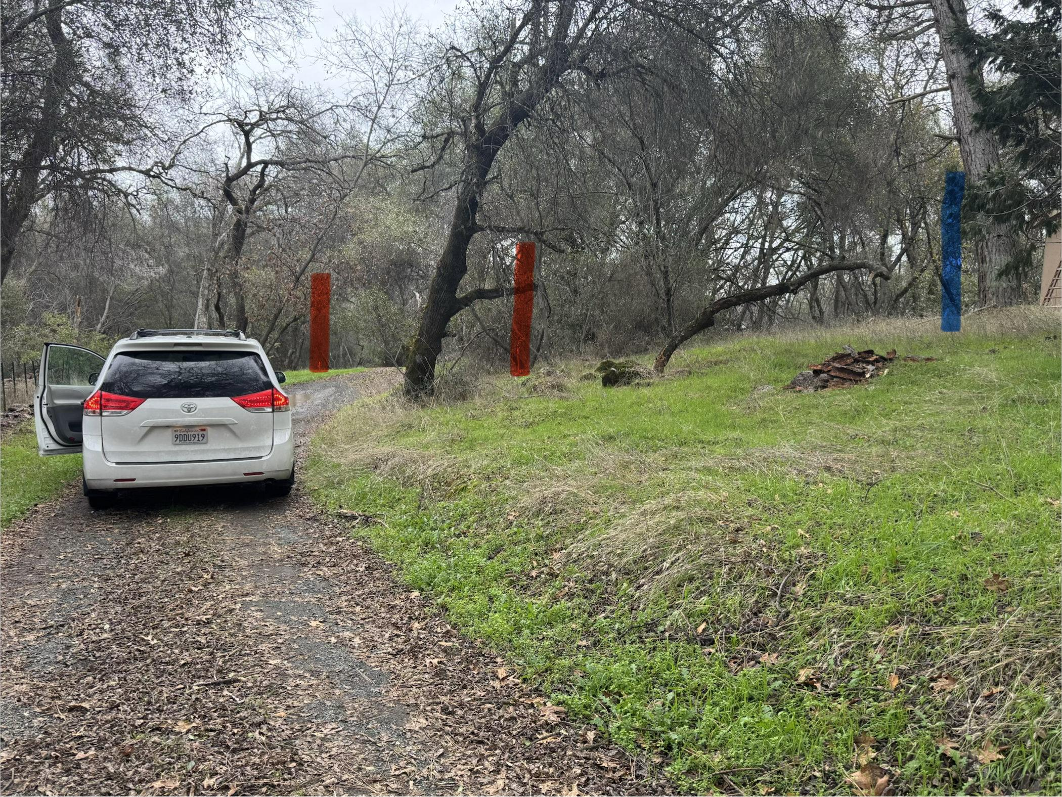

Slide 6
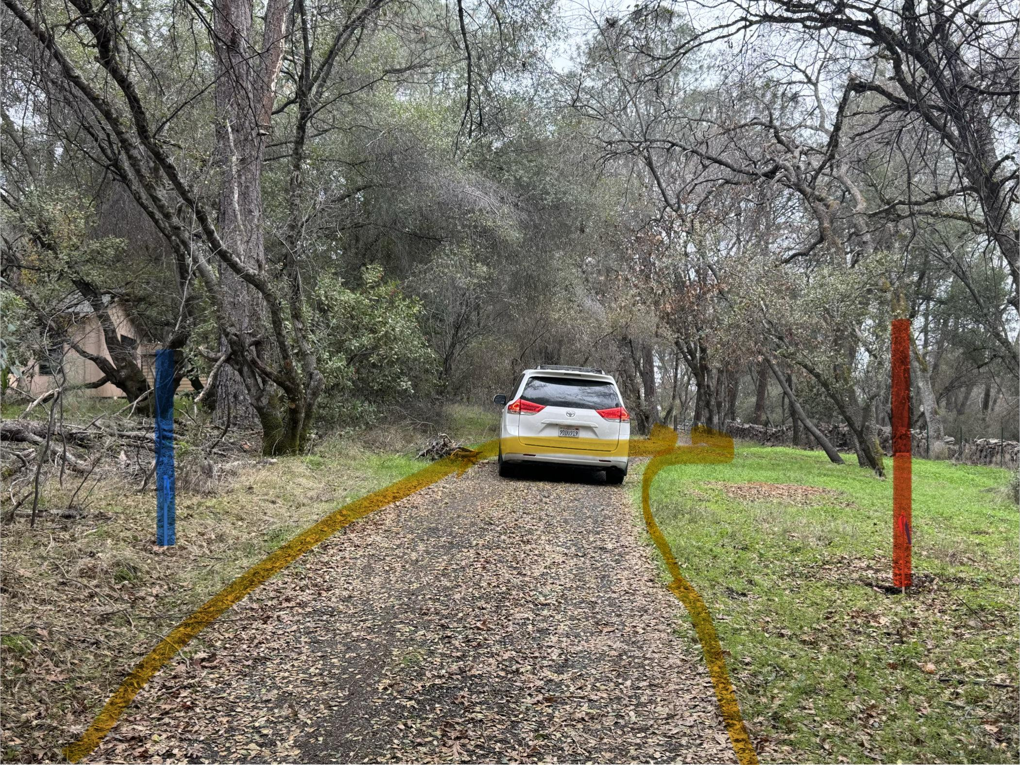

Slide 7
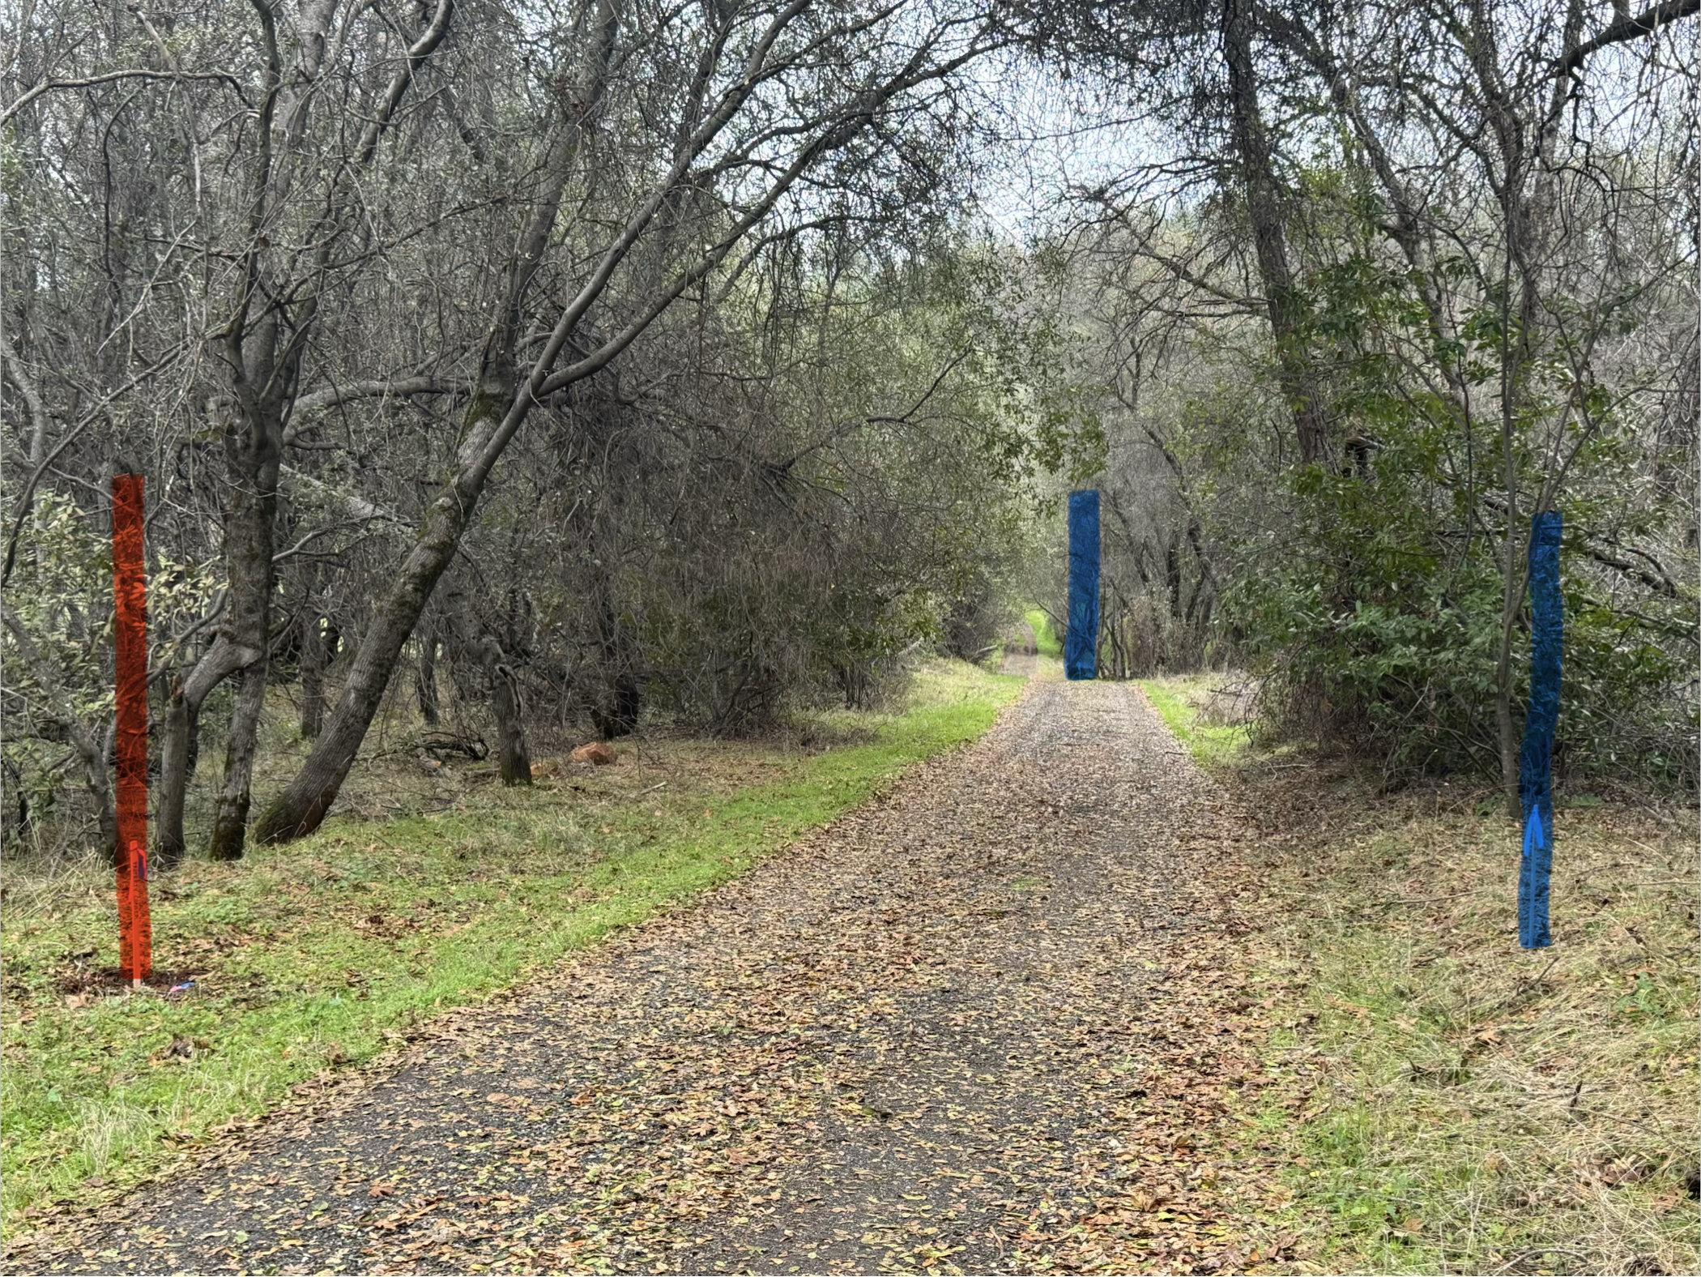

Slide 8
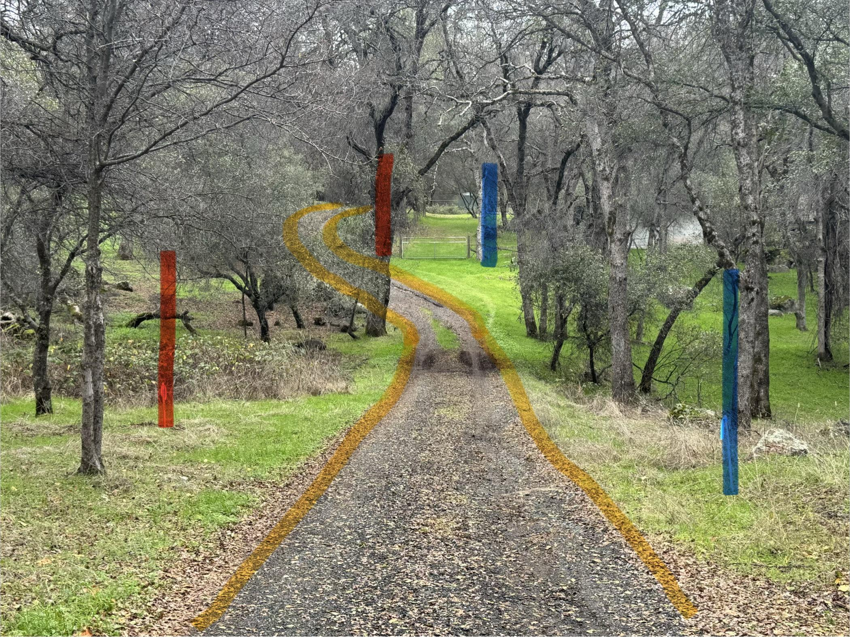

Slide 9
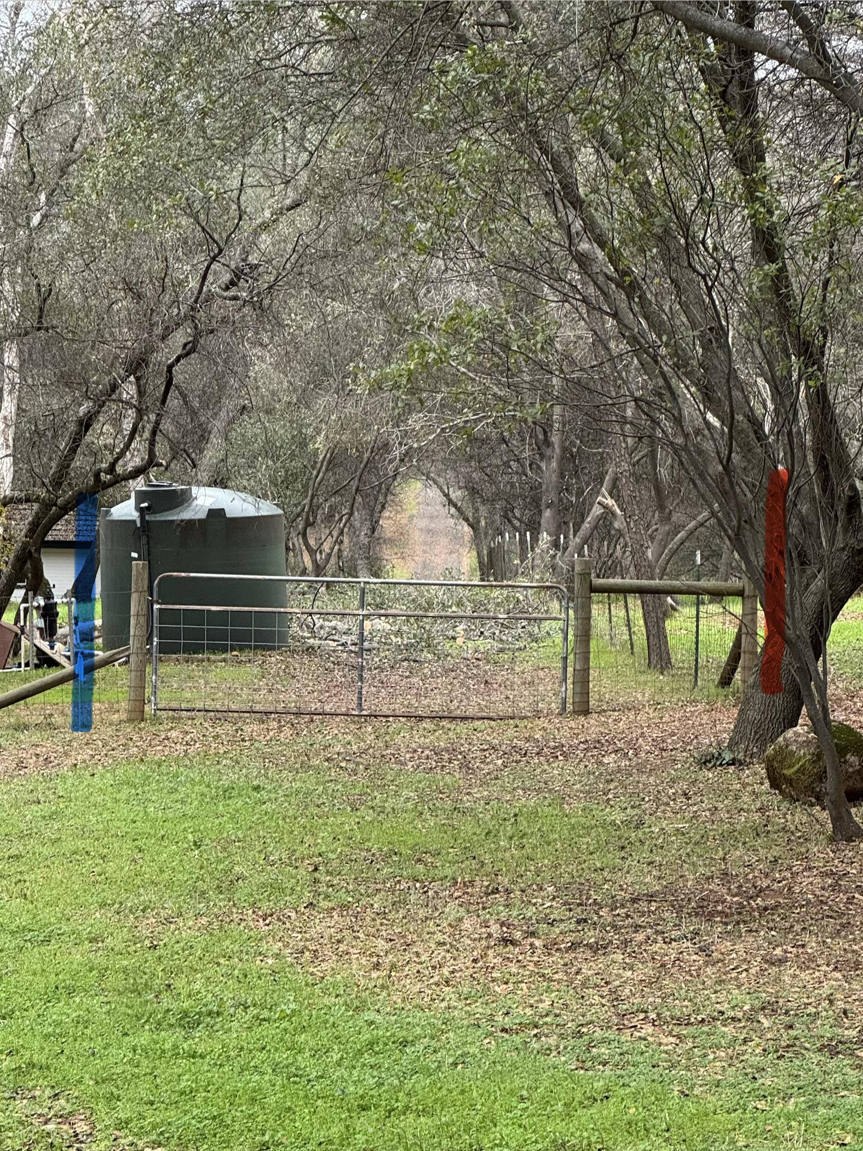

Slide 10
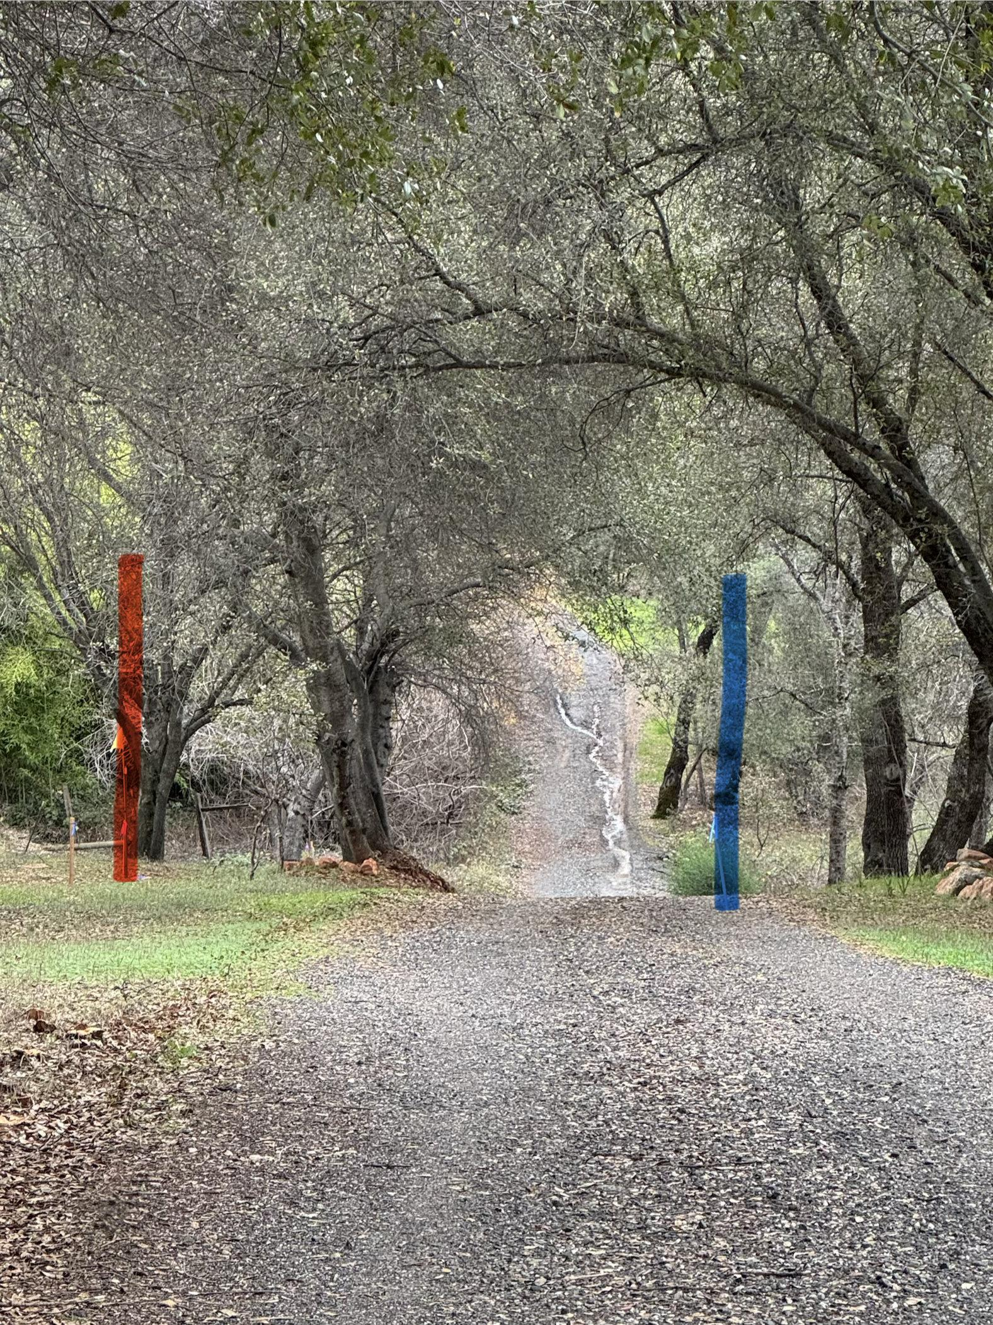

Slide 11
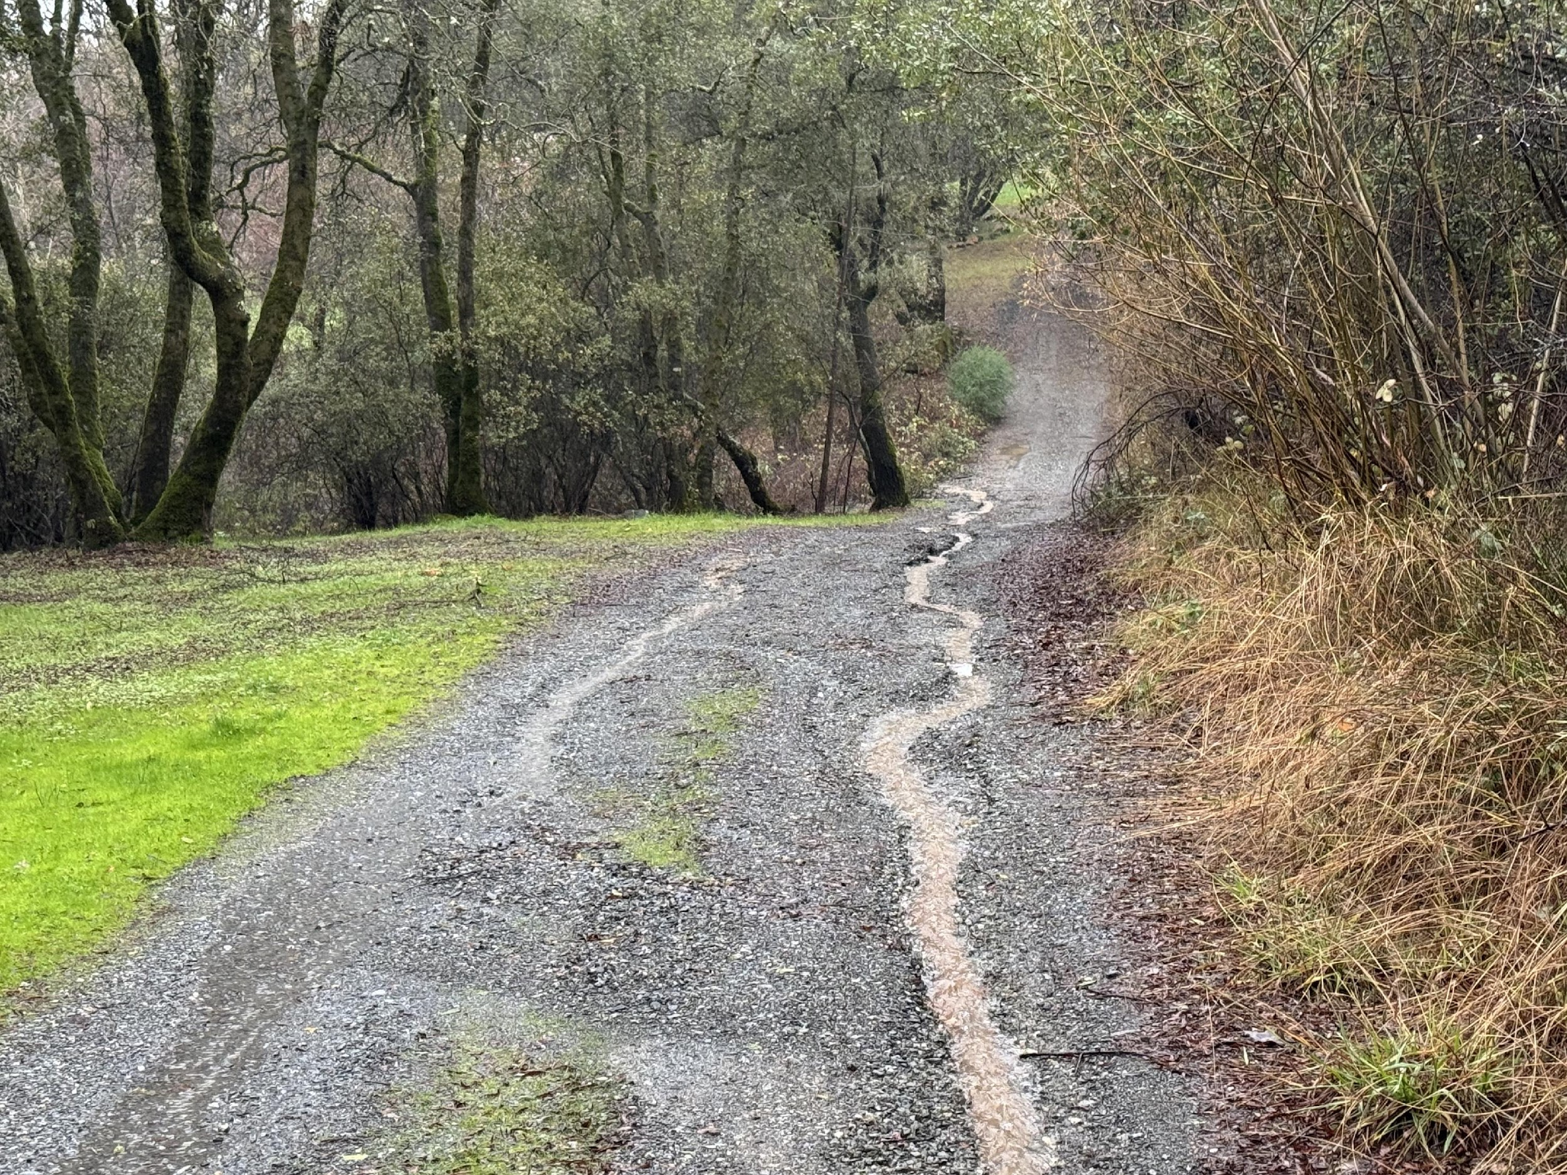

Slide 12
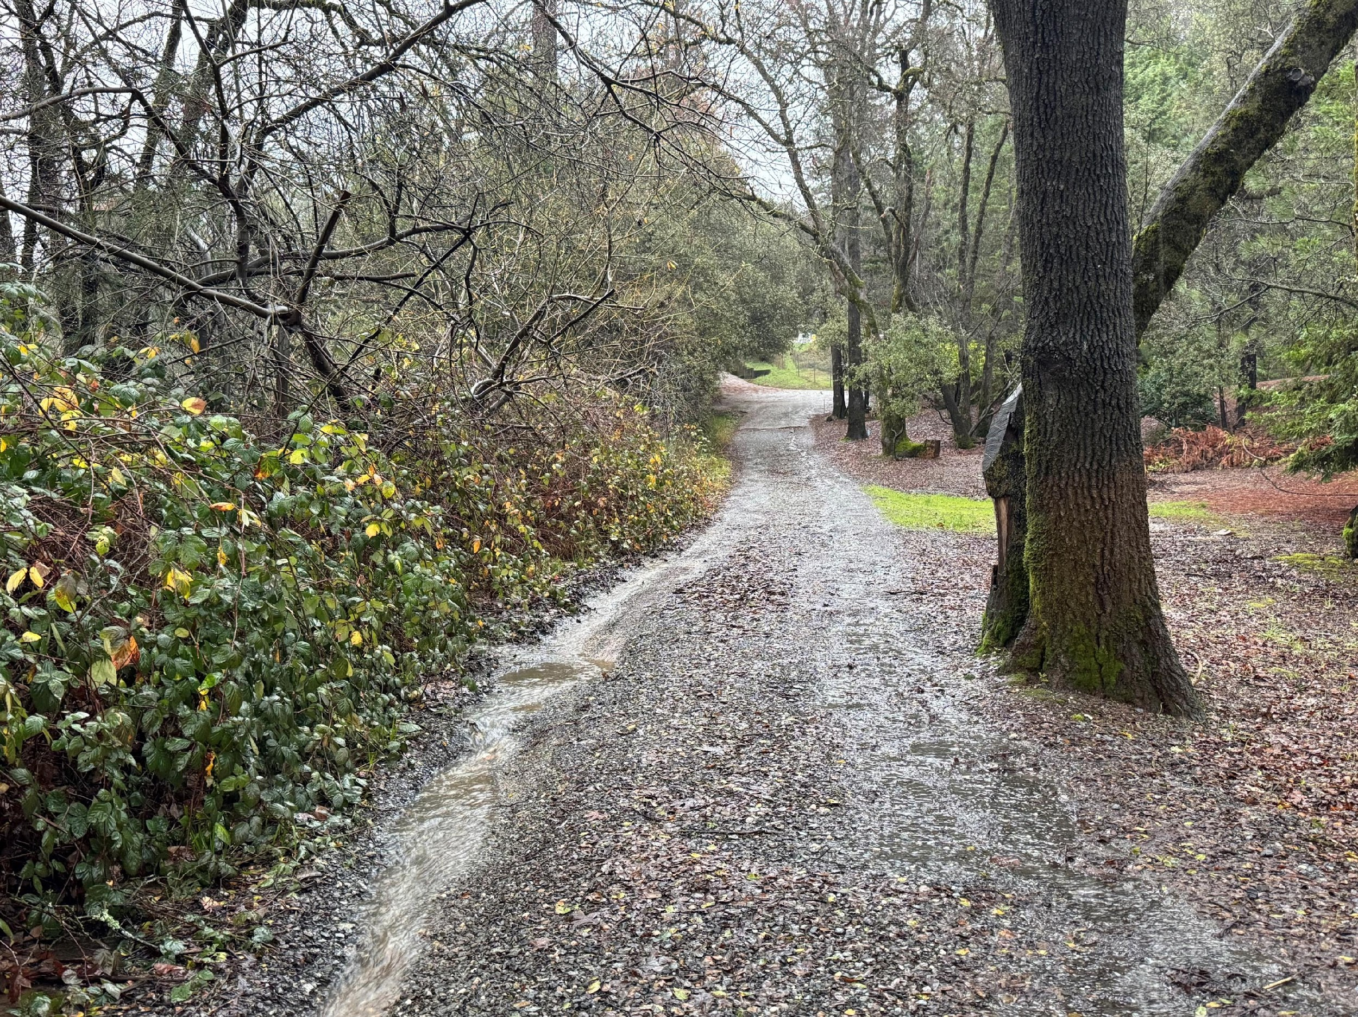

Slide 13
Easement vs Current Usage

Slide 14
Easement by Prescription
A prescriptive easement grants a non-owner the right to use another's property based on long-term, open use without permission. To establish a prescriptive easement, the following must be true:
  The use must be visible and obvious
  The use must be continuous and uninterrupted for a period of five years
  The use must occur without the owner's express or implied permission
  The user must possess a good-faith belief that they are entitled to use the property, proven by:
    Historical use by predecessors in title
    Surveys, deeds, or boundary markers that the user relied on, even mistakenly
    Improvements made in reliance on the use
    No attempts to hide the use
Payment of property taxes is not required to establish the prescriptive easement
A prescriptive easement is not automatic, typically requiring a judicial determination through a quiet title action, governed primarily by the California Code of Civil Procedure §§ 760.010 – 764.010.

